Slide 1
Learning Euler Fluid Equation Discontinuities with a Fourier Neural Operator
CS230 – Deep Learning
Taylor Brodine
Ian Hokaj

Slide 2
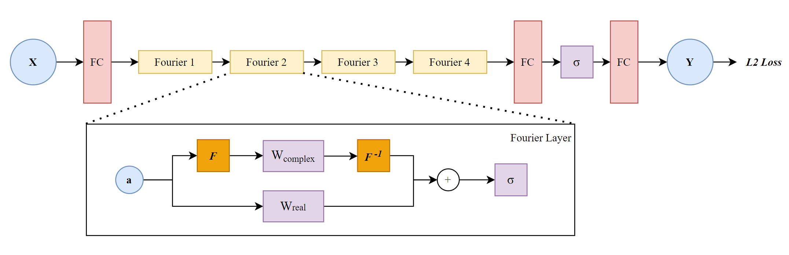
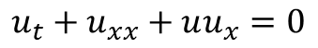


Fourier Neural Operator (FNO) Overview
Key Idea: Learn approximation of PDE solution operator
Take a standard PDE:
$$u_{t}+u_{xx}+uu_{x}=0$$
There exists an operator $𝒢$ mapping between initial/boundary conditions and solutions :
$$𝒢: a\left(x_{ic},t_{ic}\right)→u(x,t)$$
This mapping is learned by Fourier Neural Operator:
Benefits:
No prior knowledge of PDE required
Resolution-invariant
[1] Zongyi Li et al. “Fourier Neural Operator for Parametric Partial Differential Equations,” 2020.

Slide 3
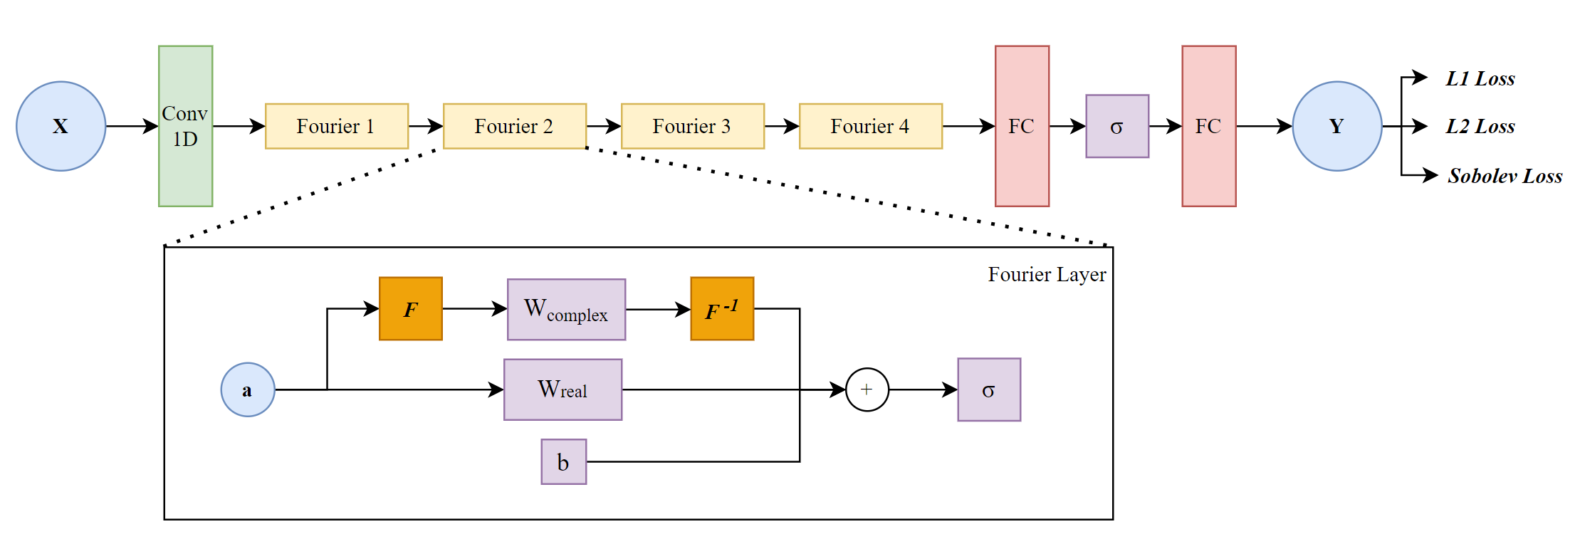
FNO Modifications
Modifications:
1D Conv Layer
Bias Layer
Normalization
Loss Function
Baselines:
Adapted FNO, same training hyperparameters
U-Net, same training hyperparameters

Slide 4
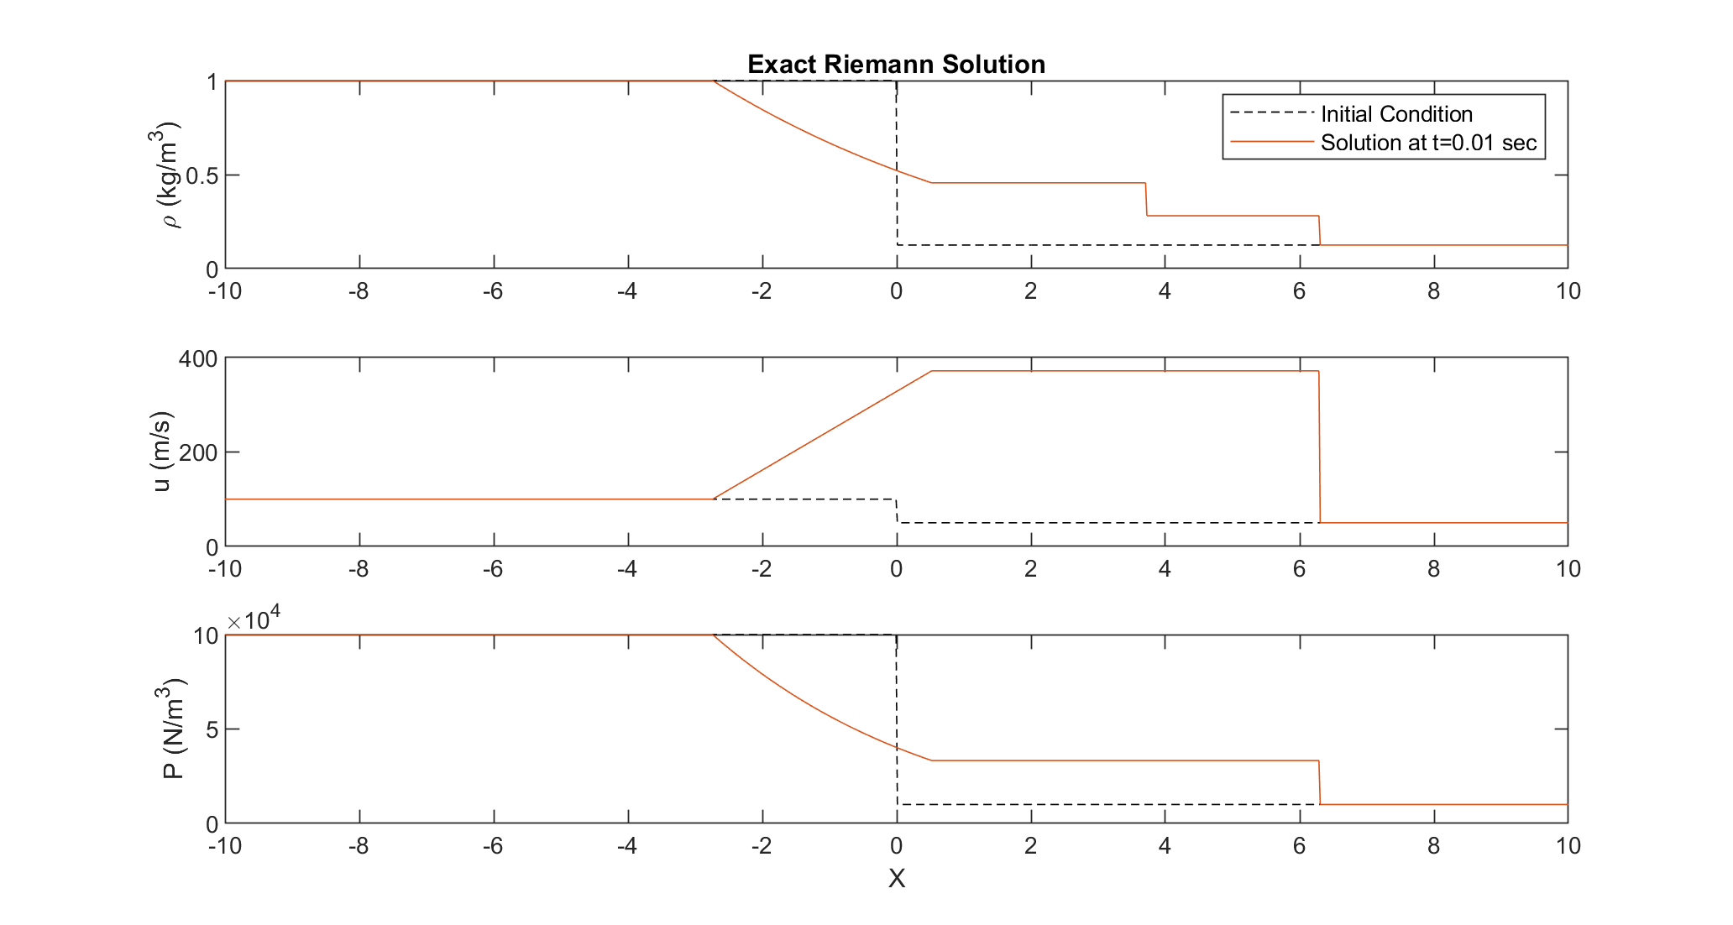
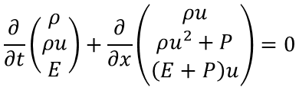
Data Generation
Solving the Euler Fluid Equations (system of PDEs):
$$\frac{∂}{∂t}\left(\begin{matrix}ρ \\ ρu \\ E\end{matrix}\right)+\frac{∂}{∂x}\left(\begin{matrix}ρu \\ ρu^{2}+P \\ \left(E+P\right)u\end{matrix}\right)=0$$
Solve system analytically using self-similarity with uniform random initial conditions
[2] C. Parkinson and M. Ceccia, "Time-Optimal Paths for Simple Cars with Moving Obstacles in the Hamilton-Jacobi Formulation," 2022

Slide 5
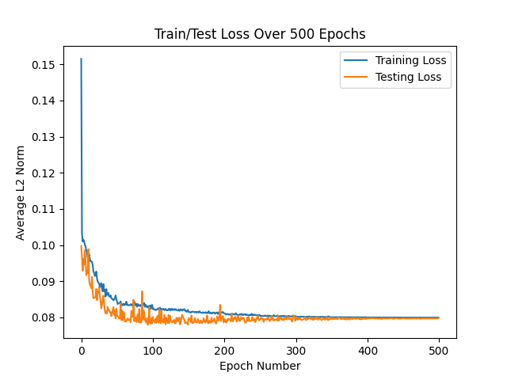
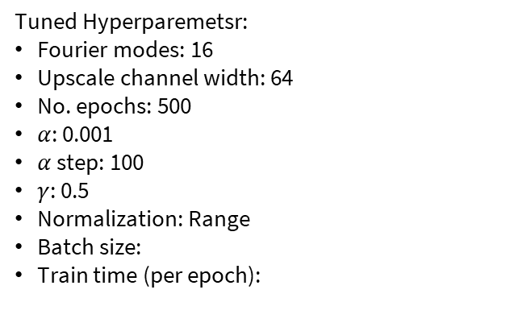
Training Results
Tuned Hyperparemetsr:
Fourier modes: 16
Upscale channel width: 64
No. epochs: 500
$α$: 0.001
$α$ step: 100
$γ$: 0.5
Normalization: Range
Batch size:
Train time (per epoch):
Overlay basline training?

Slide 6
Upscaling Performance
Both upscaling plots
[2] C. Parkinson and M. Ceccia, "Time-Optimal Paths for Simple Cars with Moving Obstacles in the Hamilton-Jacobi Formulation," 2022

Slide 7
THANK YOU

